Slide 1
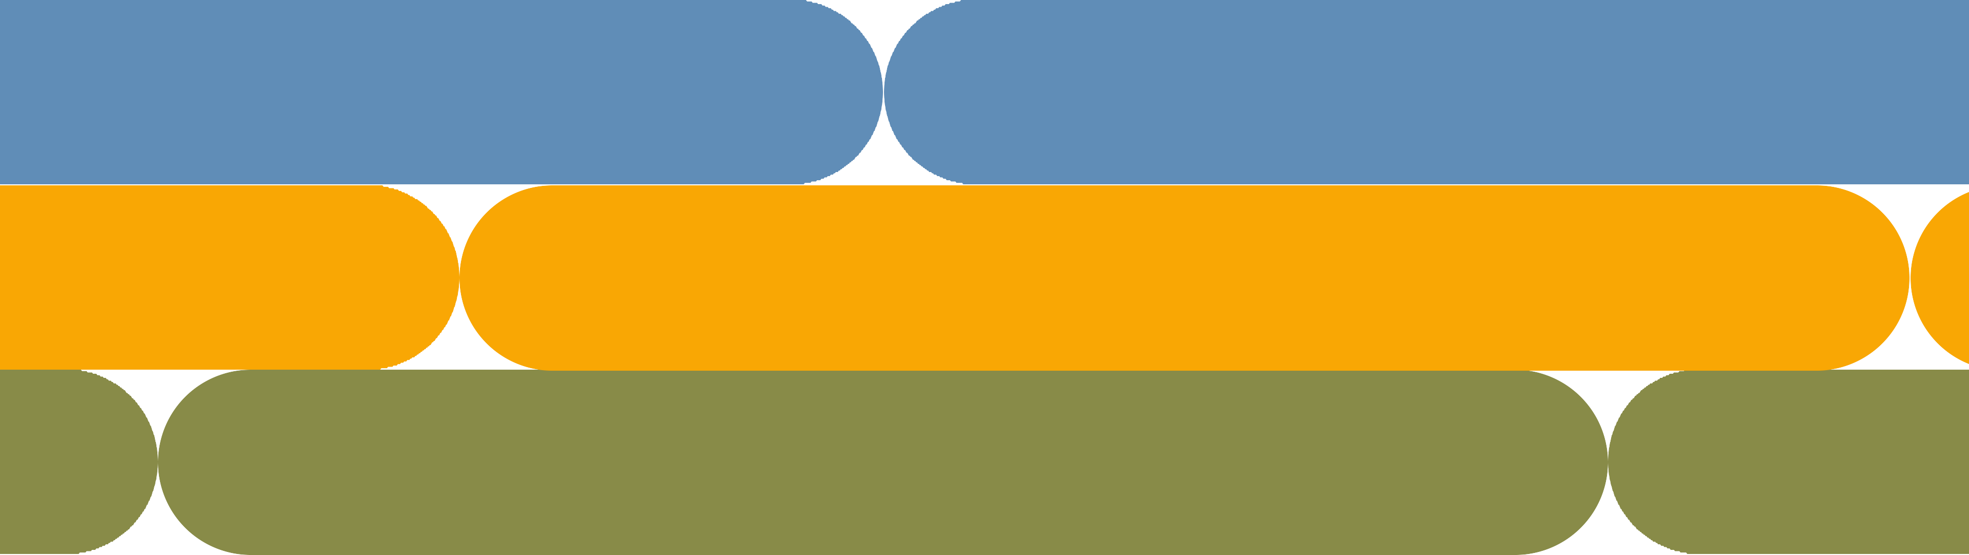
Team1 0: Diamond dataset

Slide 2


About Dataset
This classic dataset contains the prices and other attributes of almost 54,000 diamonds. It's a great dataset for beginners learning to work with data analysis and visualization.

Slide 3
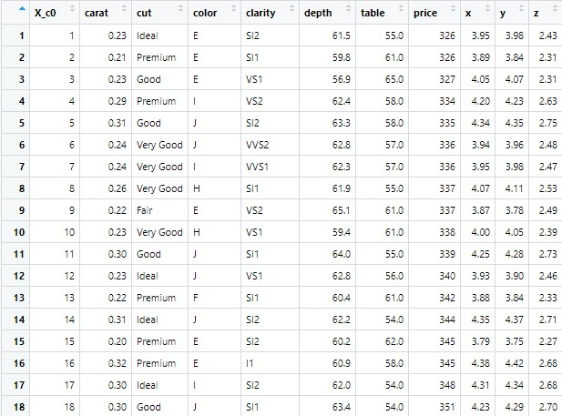
DATASET

Slide 4
Price: price in US dollars (\$326--\$18,823)
Carat: weight of the diamond (0.2--5.01)
Cut: quality of the cut (Fair, Good, Very Good, Premium, Ideal)
Color: diamond color, from J (worst) to D (best)
Clarity: a measurement of how clear the diamond is (I1 (worst), SI2, SI1, VS2, VS1, VVS2, VVS1, IF (best))
X: length in mm (0--10.74)
Y: width in mm (0--58.9)
Z: depth in mm (0--31.8)
Depth: total depth percentage = z / mean(x, y) = 2 * z / (x + y) (43--79)
Table: width of top of diamond relative to widest point (43--95)
Content

Slide 5

About this file
A data frame with 53940 rows and 10 variables:
price
price in US dollars (\$326--\$18,823) carat
weight of the diamond (0.2--5.01) cut
quality of the cut (Fair, Good, Very Good, Premium, Ideal) color
diamond colour, from J (worst) to D (best) clarity
a measurement of how clear the diamond is (I1 (worst), SI2, SI1, VS2, VS1, VVS2, VVS1, IF (best)) X length in mm (0--10.74)
Y width in mm (0--58.9) Z depth in mm (0--31.8) depth
total depth percentage = z / mean(x, y) = 2 * z / (x + y) (43--79) table
width of top of diamond relative to widest point (43--95)

Slide 6

SOURCE CODE

Slide 7
Source Code:
#installing required packeges#
install.packages('ggplot2') install.packages("statar") install.packages("dplyr")
#load required libraries# library(ggplot2)
#view dataset
diamond.dataset <- read.csv("C:/Users/KAVIN/Downloads/diamond dataset.csv") View(diamond.dataset)
#load data into my data# mydata=diamond.dataset str(mydata)

Slide 8
#summerization of the data summary(mydata)
#variance of the data var(carat)
carat=mydata$carat cut=mydata$cut color=mydata$color clarity=mydata$clarity depth=mydata$depth table=mydata$table price=mydata$price x=mydata$x y=mydata$y z=mydata$z
#summerization of data manually by adding values#
#mean of the data mean(carat) mean(depth) mean(price) mean(table) mean(x)
mean(y) mean(z)
#median of the data
median(carat)
median(depth) median(price) median(table) median(x)
median(y) median(z)
var(depth)
var(price)
var(table)
var(x)
var(y)
var(z)
#will give table to identfiy no.of outcomes#
table(clarity)
table(color)
table(cut)
#data-Barplot
barplot(table(clarity))
barplot(table(color)) barplot(table(cut))
#correlation of carat and price# cor(carat,price)
#correlation of carat and price by pearson# cor.test(carat, price, method= "pearson")
#

Slide 9

#multiple regression#
model <- lm(price~carat+depth, data = mydata)
print(model)
#create scatterplot of carat vs. price, using cut as color variable
ggplot(data=diamonds, aes(x=carat, y=price, color=cut)) + geom_point()
#create boxplot of price, grouped by clarity
ggplot(data=diamonds, aes(x=cut, y=price)) + geom_boxplot(fill="steelblue")
#create boxplot of price, grouped by clarity
ggplot(data=diamonds, aes(x=color, y=price)) + geom_boxplot(fill="steelblue")
#create boxplot of price, grouped by clarity
ggplot(data=diamonds, aes(x=clarity, y=price)) + geom_boxplot(fill="steelblue")

Slide 10

CODE

Slide 11



CODE:
Install packages:
Load Libraries:
view dataset: load data:

Slide 12

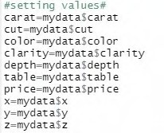
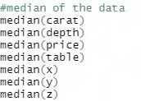

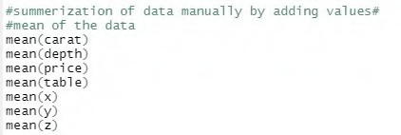
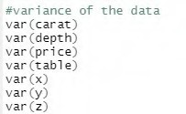
Median:
set values:
Summary
Mean:
Variance:

Slide 13

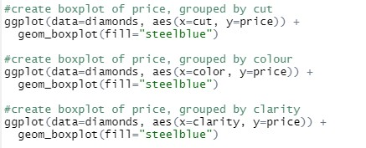


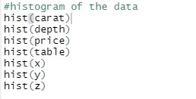



Table
bxplot for character
Bar-plot
Correlation
Histogram:
Correlation with Hy
Multi regression
SC CVP

Slide 14

RESULT

Slide 15
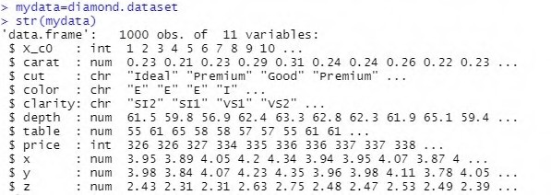
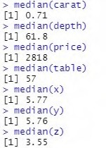
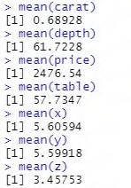
Load data result:
Median result
Mean result:

Slide 16
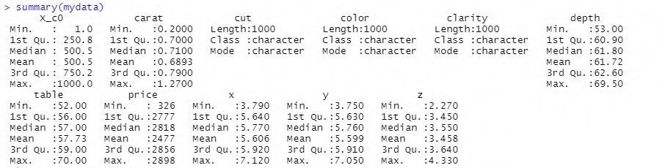
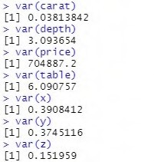
summary result:
Variance result:

Slide 17
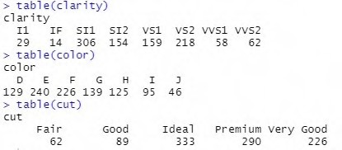
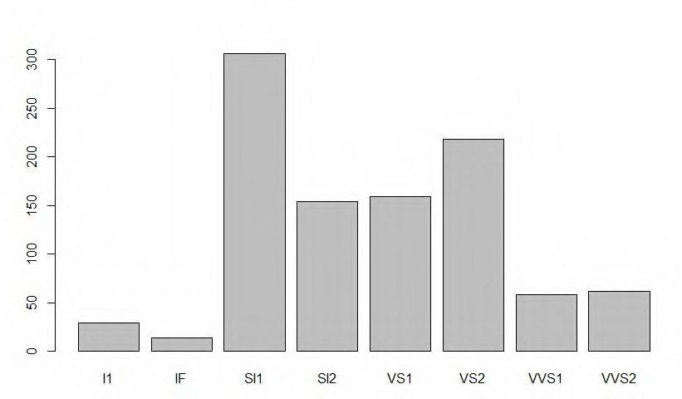
Table result:
1.Clarity of diamond (I1 (worst), SI2, SI1, VS2, VS1, VVS2, VVS1, IF (best))
2.color diamond color, from J (worst) to D (best)
3.quality of the cut (Fair, Good, Very Good, Premium, Ideal)
Bar-plot result:
(I1 (worst), SI2, SI1, VS2, VS1, VVS2, VVS1, IF (best))

Slide 18
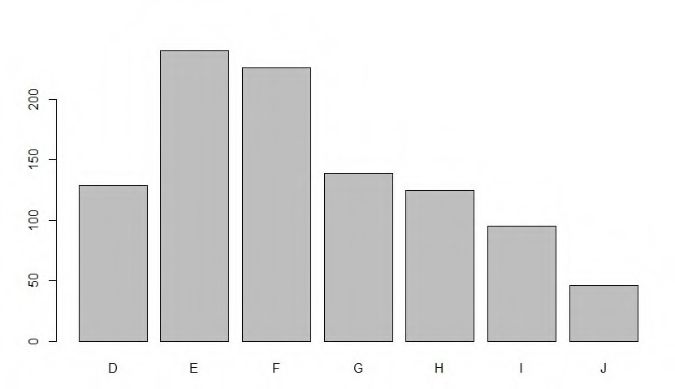
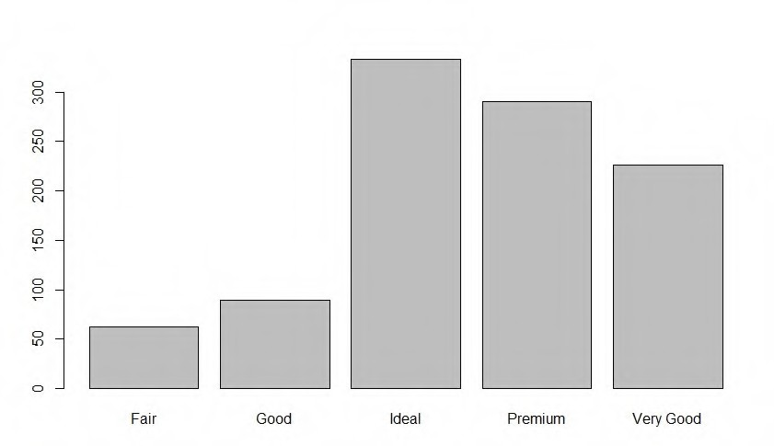
color diamond color, from J (worst) to D (best)
quality of the cut (Fair, Good, Very Good, Premium, Ideal)

Slide 19
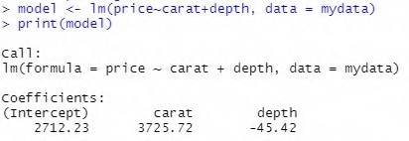
Cor result:
result:

Slide 20
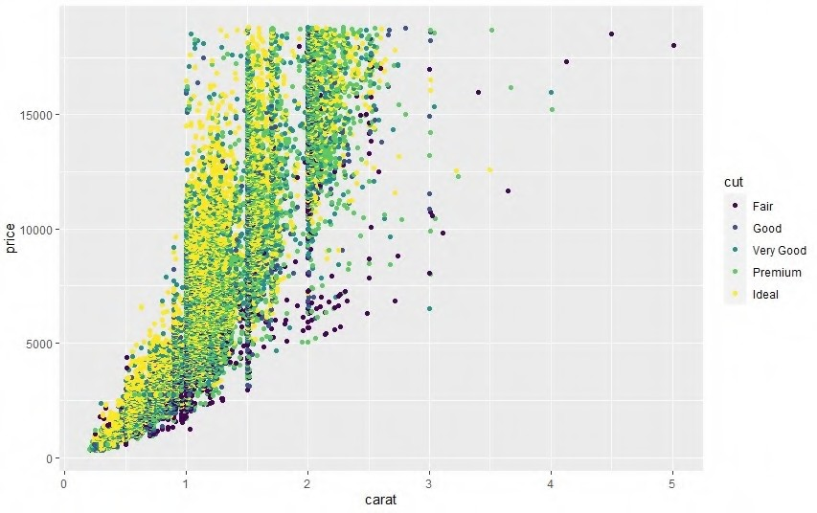
SCATTER PLOT OF CUT VS PRICE:

Slide 21
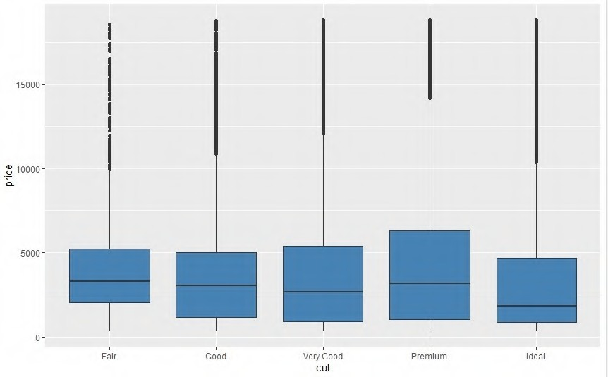
BOX PLOT OF CUT VS PRICE:

Slide 22
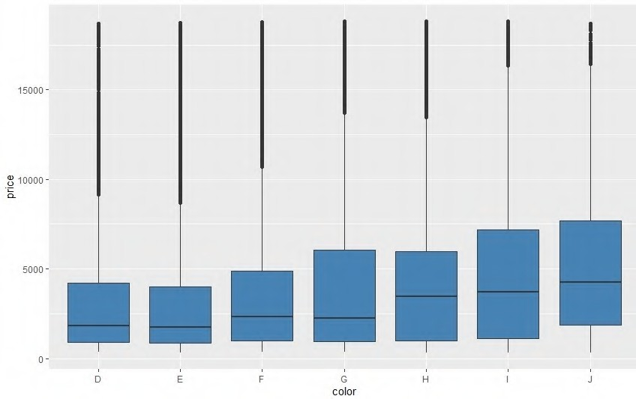
BOX PLOT OF COLOR VS PRICE:

Slide 23
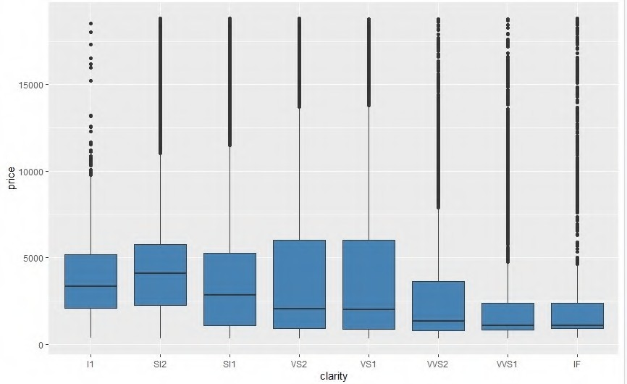
BOX PLOT OF CLARITY VS PRICE:

Slide 24
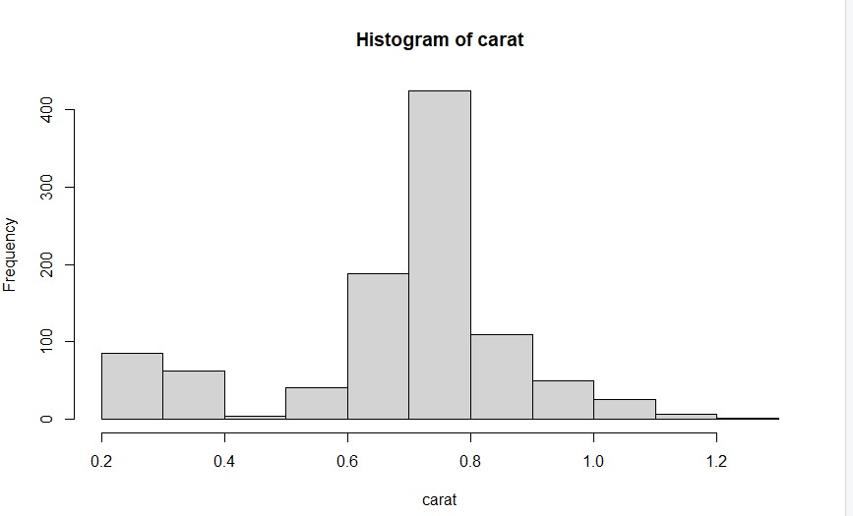
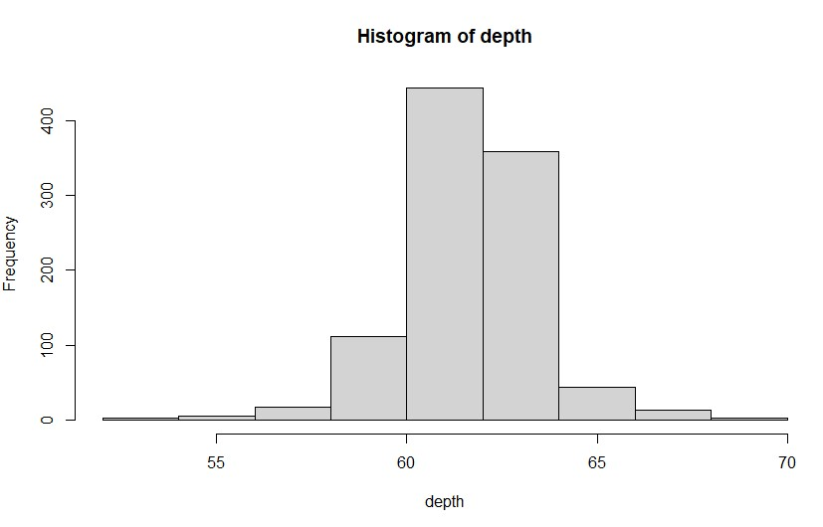
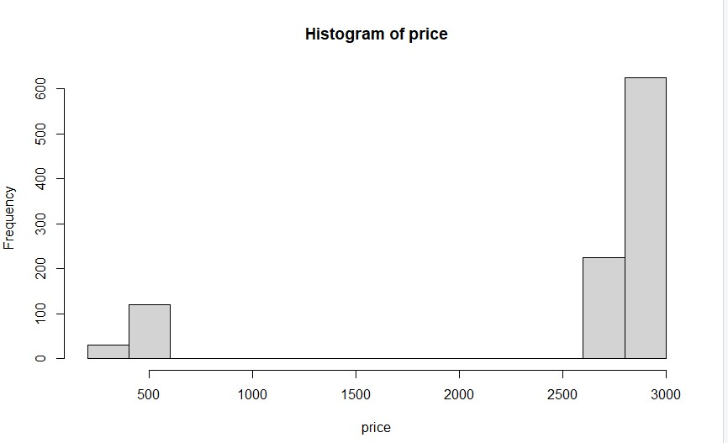
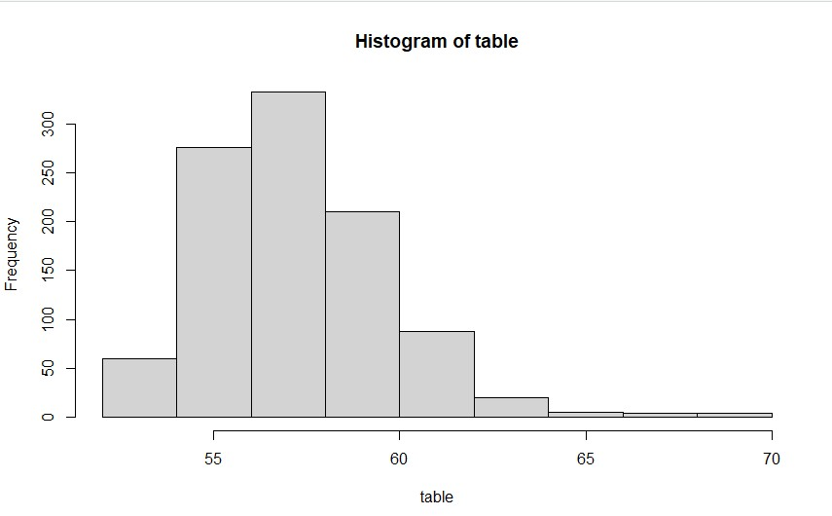
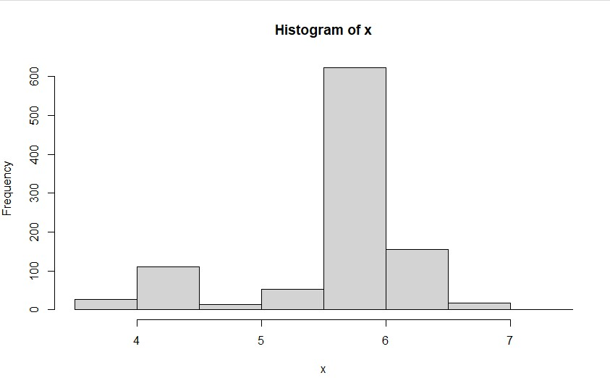
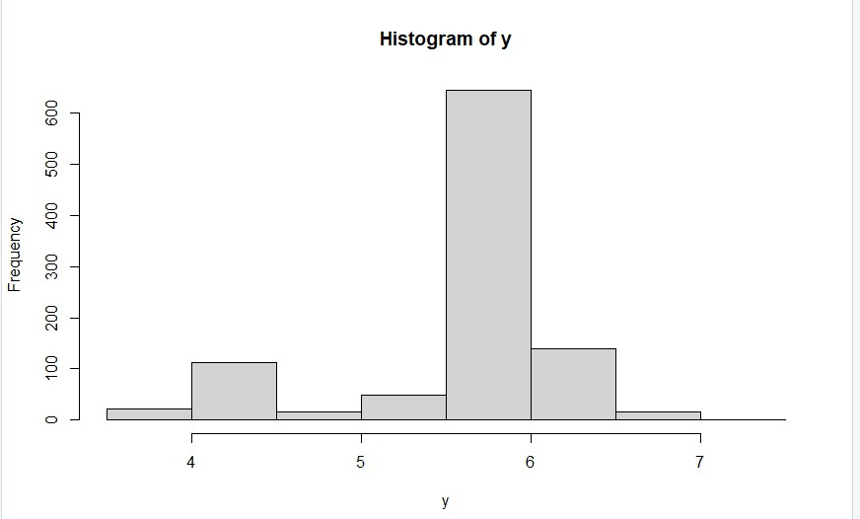
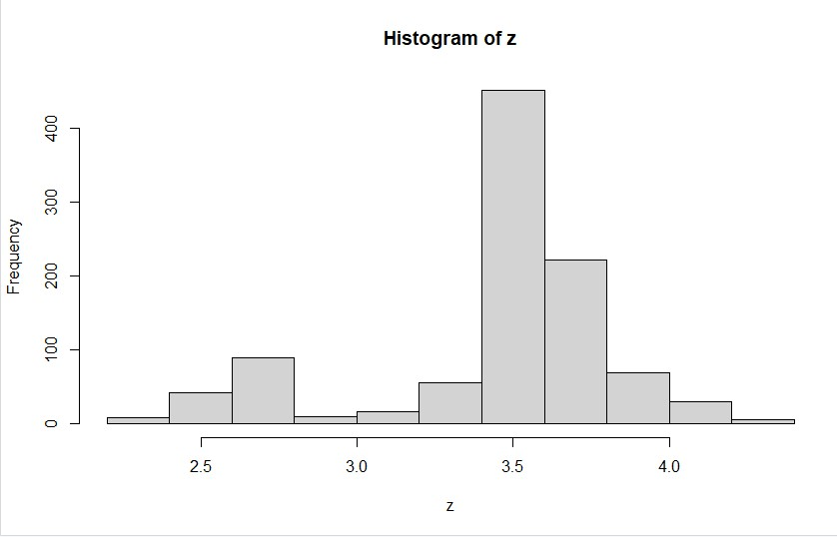

Slide 25
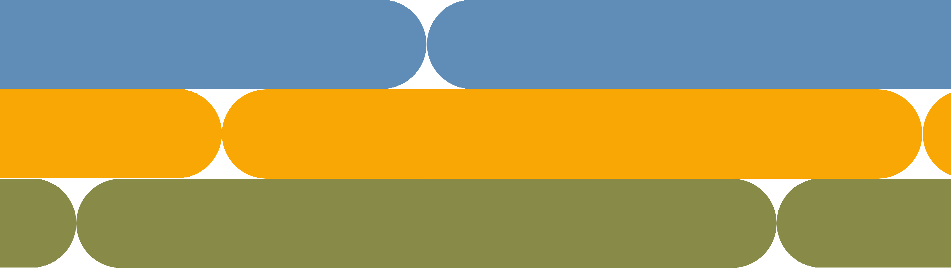
Thank you

